Slide 1
Congestion control in charging station for EVs
Under the guidance of Professor Indrajit Banerjee
Presented by :
Subham Kumar (510817008)
Moyeen Sarfaraj (510817026)
Apoorva Sharma (510817044)
Siddharth Rai (510817073)

Slide 2
Introduction
As environment preservation becomes a prominent issue around the world, electric vehicles (EVs) are poised to gain mass acceptance from the general public.
However, its limited battery life makes drivers search for a proper public charging station to be charged frequently, which increases the traffic congestion of a road network.
Solution :
Set up more Charging Stations to meet the increasing demand.
Utilize existing public charging stations effectively, by guiding EVs to be charged with minimum time cost, avoiding congestion on roads and in stations.
Navigation systems can be used to allocate stations to EVs based on sufficient integrated information, such as geography, traffic congestion in a road network, and queuing situations in each charging station.

Slide 3
Abstract
Navigation systems can help in allocating public charging stations to electric vehicles (EVs) with the aim of minimizing EVs’ charging time by integrating sufficient data.
However, the existing systems only consider their travel time and transform the allocation as a routing problem.
Here, we involve the queuing time in stations as one part of EVs’ charging time, and another part is the travel time on roads
We constructed a joint-resource congestion game to describe the interaction between vehicles and resources
With a finite number of players (vehicles) and resources (roads and charging stations) , there exists a Nash equilibrium.
To realize a dynamic allocation work, we applied the Q-learning algorithm, defining sets of states and actions in our constructed environment.

Slide 4
Some Terminologies

Slide 5
Congestion Game Model
The congestion game model is a class of non-cooperative game in which the cost of a selfish player depends on the total number of players playing the same strategy , The congestion game is a common method to solve resource allocation problems.
Roads and stations are congestible resources. They can be thought of as joint resources because roads link EVs to stations. We construct a joint-resource congestion game to describe our problem.

Slide 6
Congestion Game Model
A congestion model (N,M,(Ai)i∈N ,(cj )j∈M) is defined as follows:
N = {1..n} denotes the set of PLAYERS
M = {1..m} denotes the set of facilities/RESOURCES
For i ∈ N, Ai denotes the set of STRATEGIES of player i, where each ai ∈ Ai is a non empty subset of the facilities
For j ∈ M, cj ∈ Rn denotes the vector of COSTS, where cj (k) is the cost related to each user of facility j, if there are exactly k players using that facility

Slide 7
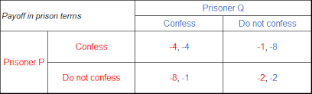
Nash Equilibrium
Prisoner’s dilemma
If P and Q each confess, each of them serves 4 years in prison.
If P confesses but Q does not confess, P will serve 1 year and Q will serve 8 years in prison.
If P does not confess but Q confesses, P will serve 8 years in prison and Q will serve 1 year in prison.
If P and Q both do not confess, both of them will serve 2 years in prison..

Slide 8
Nash Equilibrium
A Nash Equilibrium is a profile of strategies such that each player’s strategy is a best response against the equilibrium strategies of the other players.
Theorem : Every finite congestion game has a Nash equilibrium.

Slide 9
Reinforcement Learning
Reinforcement Learning(RL) is a type of machine learning technique that enables an agent to learn in an interactive environment by trial and error using feedback from its own actions and experiences.
Basic reinforcement is modeled as :
A set of environment and agent states, S.
A set of actions, A, of the agent.
P_{a}(s, s’) = Pr(s_{t+1} = s’ | s_{t} = s, a_{t} = a) is the probability of transition (at time t) from state s to s’ under action a.
R_{a}(s, s’) is the immediate reward after transition from s to s’ with action a.
A reinforcement learning agent interacts with its environment in discrete time steps. At each time t, the agent receives the current state s_{t} and reward r_{t}. It then chooses an action a_{t} from the set of available actions which is subsequently sent to the environment.
The environment moves to a new state s_{t+1} and the reward r_{t+1} associated with the transition (s_{t} , a_{t}, s_{t+1} ) is determined.
The goal of Reinforcement Learning agent is to learn a policy π : AxS → [0,1], π(a, s) = Pr(a_{t} = a | s_{t} = s) which maximises the expected cumulative rewards.

Slide 10
Q Learning
Q-learning is an off policy reinforcement learning algorithm that seeks to find the best action to take given the current state.
It’s considered off-policy because the q-learning function learns from actions that are outside the current policy, like taking random actions, and therefore a policy isn’t needed.
More specifically, q-learning seeks to learn a policy that maximizes the total reward.
We create a q-table or matrix that follows the shape of [state, action].
The next step is for the agent to interact with the environment and make updates to the state action pairs in our q-table.
An agent interacts with the environment in 1 of 2 ways :
Exploiting : Choose the best action from amongst all actions available for the state (from the q-table).
Exploration : Select any action at random and compute the q values accordingly.

Slide 11
Q Learning
The updates occur after each step or action and ends when an episode reaches some terminal point by the agent.
Here are the 3 basic steps:
Agent starts in a state (s1) takes an action (a1) and receives a reward (r1)
Agent selects action by referencing Q-table with highest value (max) OR by random (epsilon, ε)
Update q-values

Slide 12
Our Approach

Slide 13
Problem
Allocating stations for EVs has been the subject of recent study. However, most of the study has been around transforming the allocation problem into a routing problem, the aim of which was to minimize EV driving time (finding shortest route, similar to Google Maps).
In practice, for EVs, there are two kinds of charging patterns :
Dash Charging : Charge up to 80% of a vehicle’s rated battery capacity within 1 hour (Generally used in Charging Stations)
Normal Charging : Charge to the full capacity in 8 to 10 hours (Generally used at homes)
Given the above scenario, EVs’ charging process costs so much time (about 1 hour or so) that the queuing time at stations should be deemed necessary as part of their charging time cost.
A charging process can be deemed appropriate as a congestion game, in which a finite number of EVs compete for a fixed number of resources, including roads and stations, in an urban area.

Slide 14
Problem Modelling
The allocation process involves interactions between EVs and their environments.
EVs’ charging behavior will increase the congestion of routes and stations and conversely, their levels of congestion will change EVs’ charging time cost.
We can assume Roads and Charging Stations as congestible resources, and EVs as players competing for the resources.
We can construct a Joint-Resource Congestion Game to describe our problem.
Since there are a finite number of resources and a finite number of players, we can have a stable solution based on Nash Equilibrium.
Both, Route Congestion as well as Queing Time has been considered for calculating Charging cost.
The allocation process is a dynamic process with the congestion state changing every time. As the system will allocate charging stations to EVs one by one based on the present status of roads and charging stations, we can consider Q Learning (a dynamic programming method) to solve our problem.

Slide 15

Calculating Route Congestion
We denote rc_{ij} as the route trip time that EV i drives to station j. The value of rc_{ij} is decided by the vehicle’s distance to the station and the route congestion status.
A roads’ congestion situation is divided into the road’s general congestion status and the road’s game congestion status, where the latter is caused by the charging EVs.
A road’s normal congestion status caused by vehicles other than EVs heading for charging is the real-time road congestion indicator of Google Map. Let a⁰_{k} denote the general congestion status for road k.
A road’s congestion condition caused by EV charging activities is described as CO_{ik.}
Here, λ is the coordination constant, d_{ik} is the length of road k on which EV i passes, CAP_{k} is the traffic capacity of the road k, and n_{ik} denotes the number of EVs that have passed along this road.
The congestion caused by the charging EVs on road k is computed as CO_{ik} =n_{ik}/CAP_{k} .

Slide 16

Calculating Queuing Time
Once the station j is fixed for a EV_{i} , it will be waiting in a queue when it arrives at the station.
The system needs to predict the queuing length in j at the time of i arriving (not at the time of i requesting). During the interval, there will be some EVs who leave the station after charging. We need to collect the number of EVs in and out of the station in a timely manner.
The initial status in each station is zero vehicles, and the charging service time CST is the same for each EV.
Providing that the number of EVs in the station j is n_{rj} when EV_{i} requests charging, the number of EVs nª_{ij} in station j when EV_{i} arrives can be estimated as nª_{ij}=n^{r}_{j} - mod(rc_{ij} / CST).

Slide 17

Our Joint Resource Congestion Game Model
(1) Players : The set N = {1, 2, . . . , n} denotes EVs heading for charging, and its cardinality |N| represents the number of EVs.
(2) Joint resources: The set M = {1, 2, . . . , m} denotes the charging stations, and its cardinality |M| represents the number of stations. The set K = {1, 2, . . . , k} denotes the finite number of roads which make up the traffic network for EVs heading to stations. They are both open resources shared among EVs.
(3) Strategies:
(4) Payoff :
denotes the costs of congested resources (i.e., roads and stations), varying according to the number of EVs allocated to them.
Optimise the function : k,m argmin

Slide 18
Existence of Nash Equilibrium
In our problem, there is a finite number of charging stations, roads (resources), and EVs (players).
As the number of EVs choosing the same charging station and roads increases, the roads and charging station will be more congested and their usage costs increase incrementally.
Once an EV find its suitable route and station, the system achieves a temporary equilibrium status to deal with the later EV until all EVs are allocated.
No EV can decrease its cost by unilaterally changing its own strategy.
Thus, in our case, c_{i}(s*_{i} , s*_{-i}) < c_{i}(s_{i} , s*_{-i}), i∈N, s_{i}, s_{-i} ,s*_{i} ∈ S^{t} , where s*_{i} is the optimized strategy vector of EV i. s*_{−i} denotes the strategy vector profile of players except for EV i.
The above condition shows Nash Equilibrium and hence we can reach to a stable strategy.

Slide 19
Implementation

Slide 20
Implementation
There are three basic elements in the algorithm: environment, state, and action. We will introduce the algorithm after setting the elements.
The environment is a fundamental element in Q-learning, in which the agent chooses its actions according to corresponding rewards.
According to the joint-resource congestion game model, the environment involves roads with their length and traffic status and optional stations with their queueing cost.
We construct a grid world whose unit is determined by the shortest road length, and deploy resources in the grids according to their relative distances.
If a road is not an integer multiple of the unit, it will cross a number of grids. There should be some grids containing segments of two joint roads. The payoff of each grid is initialized as the road’s general congestion status.
For those grids containing mixed roads, if their general congestion statues are different, the grid’s initial payoff is set as the higher value. The accessibility of roads can also be shown in the grids by setting its initial payoff value as a large value.
The state set in our scene is to make the position of the agent visible. Each grid is a state, and the state set can be denoted as state = {1, 2, . . . ,s}, where s is the total number of grids.
For each grid, it has an incremental reward once it is on the route the agent chooses, whose value is determined by its road game congestion status. In this way, the system records the agent’s accumulated reward from the environment and its action effect on the environment.
In the grid world, the agent can move up, down, left, and right. That is, the action set can be denoted as Action = { up, down, left, right}. By taking an action the agent will change its state.

Slide 21

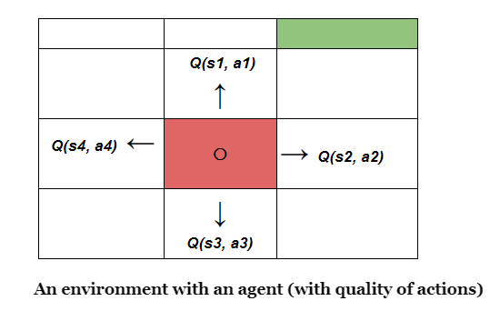
Implementation
The Q-learning algorithm is based on an action–value function. It has two input parameters: state and action. Our aim is to minimize the charging time cost.
Update the state–action function (the controller function) by the Bellman equation, with the temporal difference method as :

Slide 22
Implementation
Here 𝛂 ∈ [0,1] is the learning rate, 𝛾 ∈ [0,1] is the discounting factor, r(s,a) is the immediate reward and Q_{t}(s,a) is the Q-value at time t
For each EV, there is a learning process. The reward of each grid is updated once an EV finishes its learning. . All possible state–value pairs are tested .

Slide 23
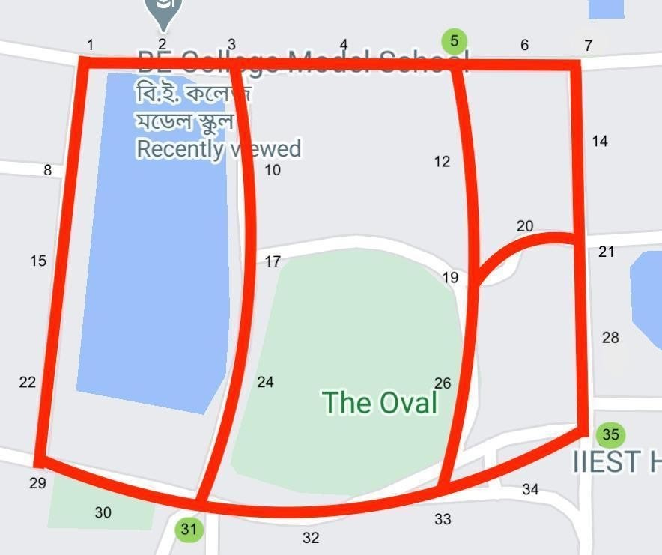
Our Map

Slide 24
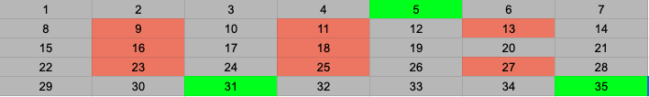
Map represented in a Grid World

Slide 25

Initial Reward Table

Slide 26
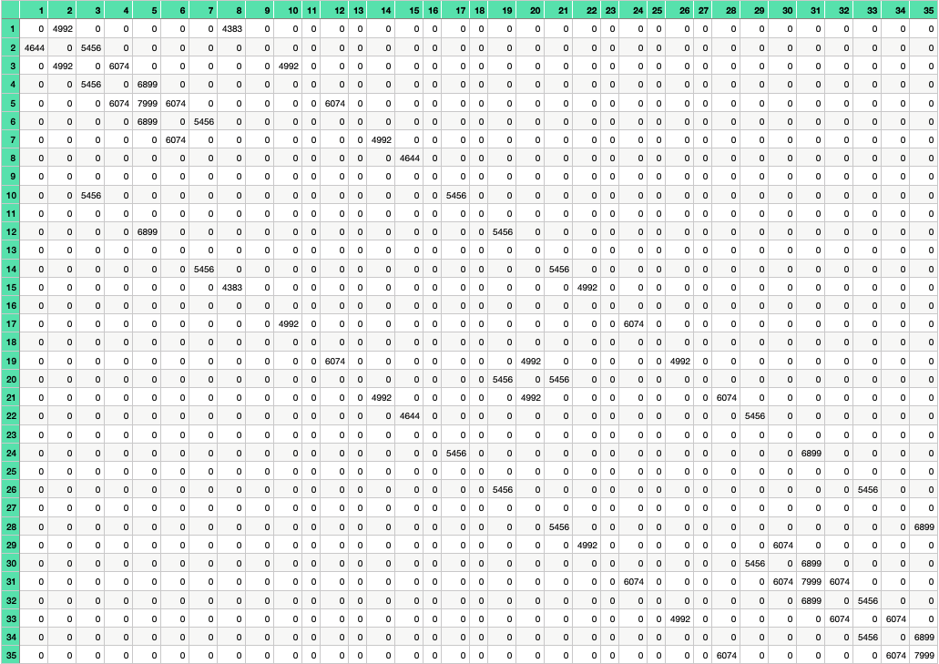
Q Table after Initialisation

Slide 27
Pseudocode
Initialization :
2D Matrix of State x Actions (Q)
Rewards (Data Structure) with each road’s average congestion factor (Rewards).
Allocation array [M]
Set the terminal_Set
for each EV :
for each Episode:
choose action A in current state S using policy 𝜀 - greedy
for each step of the episode:
take action A, observe reward R in final state S’
choose action A’ from state S’ using policy 𝜀 - greedy
update (S,A) with Bellman Equation
S ← S’ ; A← A’ ;
update Rewards for passing roads and selected station
until S is in TerminalSet
update the Allocation

Slide 28
Code Implementation
The algorithm has been coded in Python.
It is a multi threaded implementation of the resource allocation problem where each EV requesting charging is assigned a thread which finds it optimal route and keeps the resource(Charging Station) occupied until the completion of its charging time. After which the resource is de allocated.
Assumptions :
There are 3 different classes of EVs, each having their own Battery capacity.
Each unit of Battery takes 1 second to get charged.
Negligible amount of charge is spent in travelling from the point of request to the Charging Station.
The charging time is calculated based on the total battery capacity and remaining charge.
The Dynamic Price is fixed based on the congestion at the Charging Station (more the congestion, more the price).

Slide 29
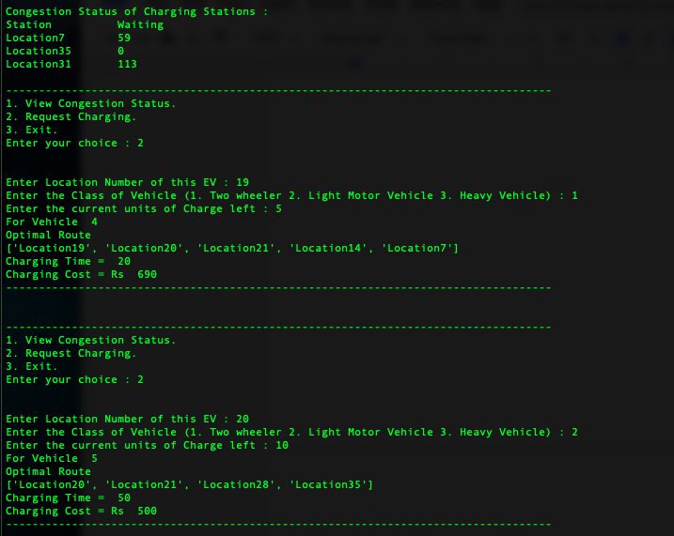
Sample Input and Output

Slide 30
Conclusion
We investigated a strategy for the allocation of EVs to stations with a reinforcement learning Q-learning Algorithm, which can be deployed on navigation systems.
We considered time costs both on roads and at charging stations, which were affected by their congestion status.
We used a grid world to set the simulation environment. The target stations were fixed in special grids according to their distance from the start point.
Each grid had its own reward, which was mapped as the time costs of using its corresponding road or station.
We allocated stations to EVs one by one. The terminal allocation result for each EV was the station minimizing its charging time cost and the price was dynamically calculated.
Each EV’s strategy was determined by the environment in which it was.

Slide 31
Future Work
Include the Real Time Traffic Congestion Data into the Algorithm.
Include the Amount of Charge being spent to travel from the Point of Request to the Charging Station.
Allow EV drivers to choose their charging stations based on the Dynamic Price.
An application can be created to automate the whole process using GPS location and the Current Battery information received from the EV control unit.

Slide 32
References
Johari, R.; Tsitsiklis, J.N. Network Resource Allocation and A Congestion Game: The single link case. In Proceedings of the 42nd IEEE International Conference on Decision and Control (IEEE Cat. No.03CH37475), Maui, HI, USA, 9–12 December 2003
Rosenthal, R.W. A Class of Games Possessing Pure-Strategy Nash Equilibria. Int. J. Game Theory 1973, 2, 65–67
Akbari, M.; Brenna, M.; Longo, M. Optimal Locating of Electric Vehicle Charging Stations by Application of Genetic Algorithm. Sustainability 2018, 10, 1076.
An introduction to Q-Learning: Reinforcement Learning.
Simple Reinforcement Learning (towardsdatascience.com)

Slide 33
Thank You

